Slide 1

Cross-Platform CPU Performance Analysis of Classic Algorithms
Comparing naive vs optimized implementations on Intel and AMD CPUs.
By:
Sohaila Ahmed, Ahmed Hany, Salma Rashedy

Slide 2
Research Scope and Methodology
Hardware & OS
Algorithms
Languages
Intel Core i7 and AMD Ryzen 5 on Ubuntu 22.04 Linux.
Binary, Linear, Jump, Interpolation, Recursive Linear, Sentinel Search
C and Go (compiled)
Python and Ruby (interpreted)

Slide 3

Optimization Techniques
Compiler Flags
Code Optimizations
Used -O0 and -O3 for C; Go builds with and without optimizations.
Loop unrolling, arithmetic simplification, prefetching-friendly access.
Performance Tools
Linux perf stat and time for CPU cycles, instructions, CPI, IPC.

Slide 4
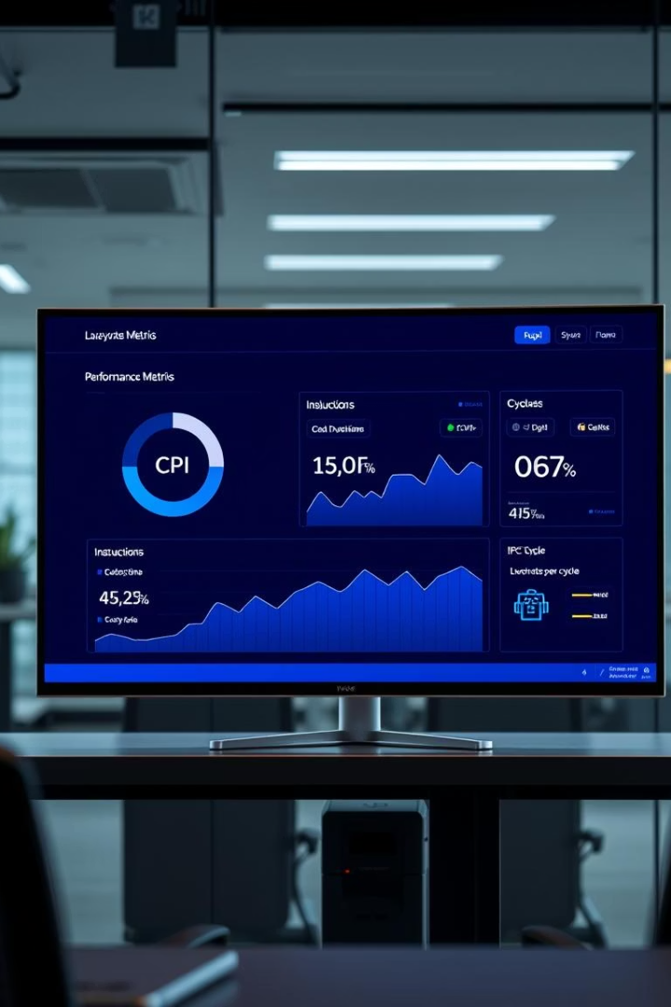
Performance Metrics Overview
Metric
Description
CPI
CPU Cycles per Instruction
IPC
Instructions per CPU Cycle

Slide 5
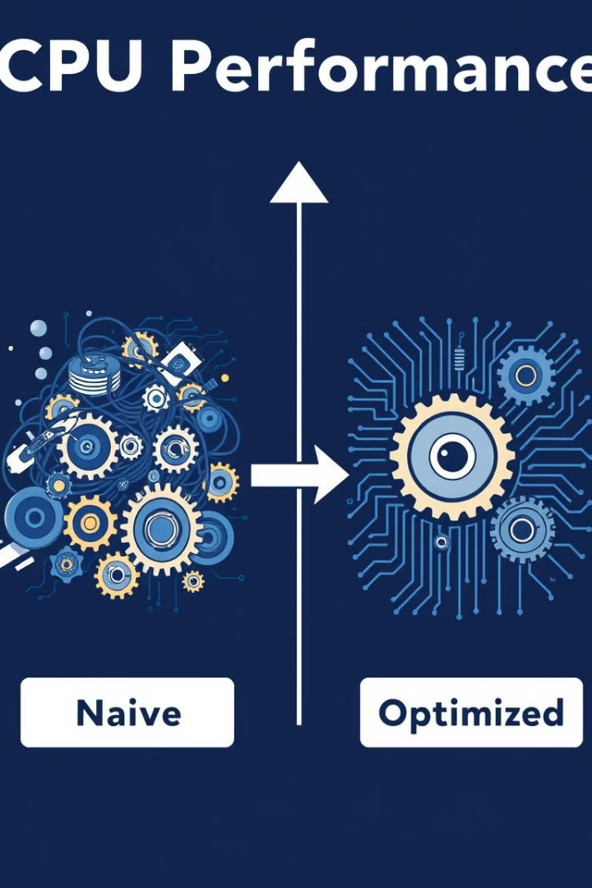
Key Results: Compiler Optimization Impact
C Language
Go Language
Optimization halves CPI and nearly doubles IPC on Intel and AMD.
Moderate CPI reduction (25–35%) and IPC gains (30–35%) due to runtime overhead.
Interpreted Languages
Python and Ruby show less variation; no compilation optimizations applied.

Slide 6
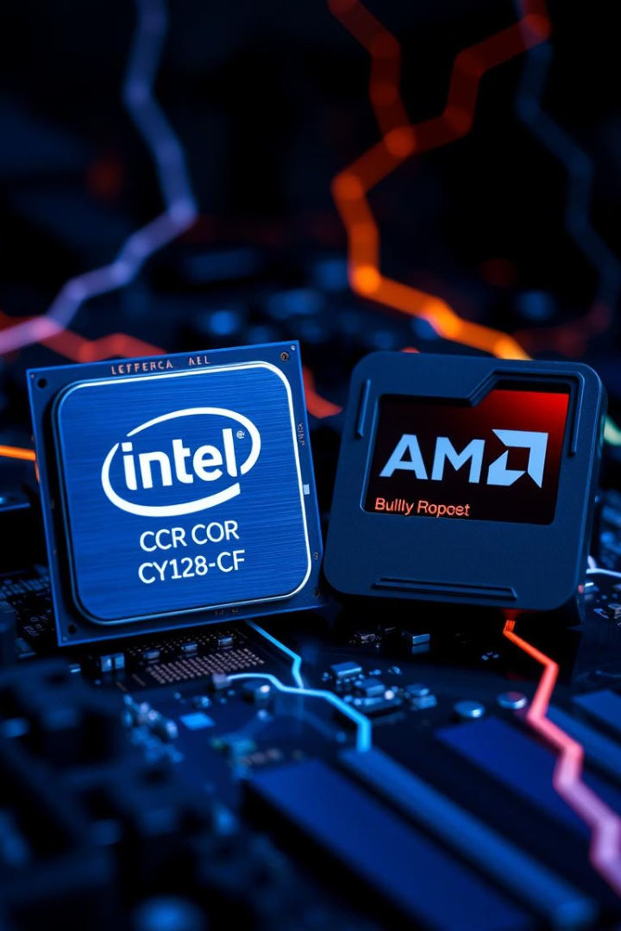
Intel vs AMD CPU Performance
Intel CPUs
AMD CPUs
Consistently better IPC than AMD across all tests.
Lower IPC and higher CPI, reflecting architectural differences.
Implications
Intel’s microarchitecture favors instruction-level parallelism and branch prediction.

Slide 7
Language Runtime Effects on Performance
C Language
Go Language
Python & Ruby
Minimal runtime, closer to hardware, best overall performance.
Runtime overhead from garbage collection limits peak gains.
Interpreted, no compiler optimizations, stable but lower efficiency.

Slide 8
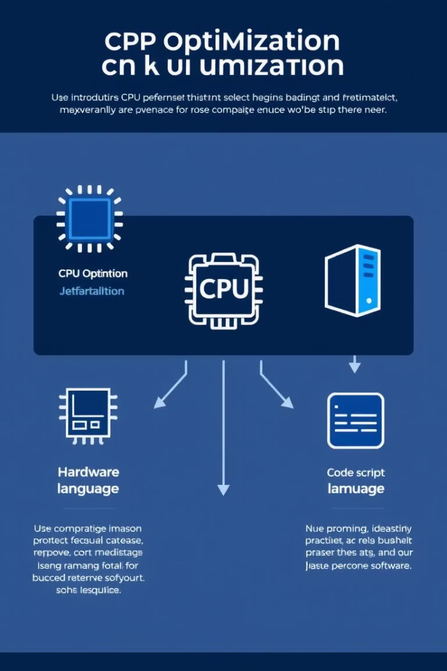



Summary of Findings
Compiler Optimizations
Most significant factor improving CPU efficiency.
Hardware Architecture
Intel outperforms AMD in IPC under tested conditions.
Language Runtime
Runtime overhead limits optimization benefits, especially in Go.

Slide 9

Conclusion and Future Work
Conclusion
Compiler optimizations and hardware architecture are key to performance.
Limitations
Go runtime overhead restricts gains compared to C.
Future Work
Expand analysis to more algorithms, languages, and OS platforms.

